Slide 1
Parking Lot Management

Slide 2
Content
Introduction
Main Functionality
Parking Strategy
Application Overview
Technologies used
Architecture
Database
Use cases – User & Admin
Demo

Slide 3
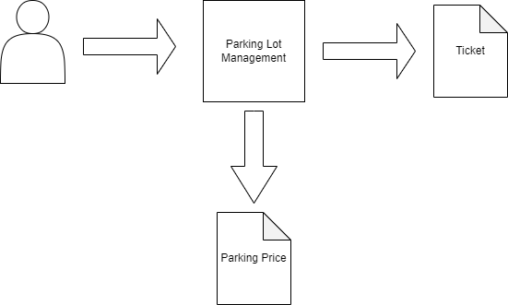
Introduction – Main Functionality
Parking Lot Management is an application that allows users of different types (regular, vip) to park their vehicles (motorcycle, car, truck) on different parking spots (small, medium, large) based on a specific parking strategy.
A ticket is generated if a vehicle is successfully parked.
After leaving the parking spot, a parking price is calculated.

Slide 4
Introduction - Parking Strategy
Vehicles can be electric or not electric
Parking spots can have electric charger or not
Users of any type can park:
Motorcycle – Small Parking Spot
Car – Medium Parking Spot
Truck – Large Parking Spot
The VIP users can also park:
Motorcycle
– Medium Parking Spot, if there are no small parking spots
– Large Parking Spot, if there are no small parking spots, and no medium parking spots
Car
– Large Parking Spot, if there are no medium parking spots
First option when choosing a parking spot regarding the electric charger is the power source of the vehicle – that means if the vehicle is electric, then a parking spot with electric charger has bigger precedence instead of a parking spot without electric charger and vice-versa.

Slide 5
Application Overview - Technologies
Technologies used
Spring Boot v2.7.5 – used for the server side
MongoDB v4.7.0 – used for storing data
Morphia v2.2 – ODM (object-document mapping) for simplifying the process of working with MongoDB database
Angular v15.1.4 – used for the client side

Slide 6
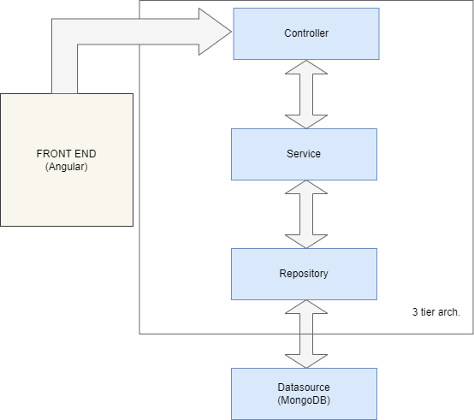
Application Overview - Architecture
Three-tier architecture
Presentation Layer - The REST controllers that expose endpoints, responsible for handling user requests and responses
Business Logic - The services contain the business logic, responsible for implementing the application's logic
Data Storage Tier - the repositories are responsible for interacting with the MongoDB database to persist and retrieve data, responsible for handling data storage and retrieval
The three-layered architecture promotes modularity, maintainability, and scalability by separating concerns, facilitating code reuse, and enabling each layer to be scaled independently. These benefits make it easier to develop, maintain, and scale complex applications over time.

Slide 7
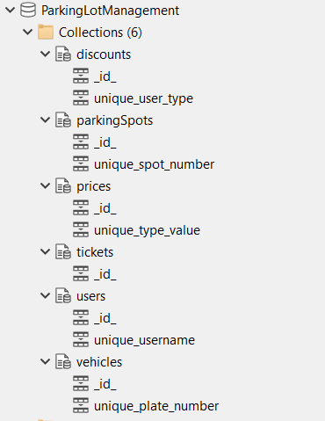
Application Overview Database

Slide 8
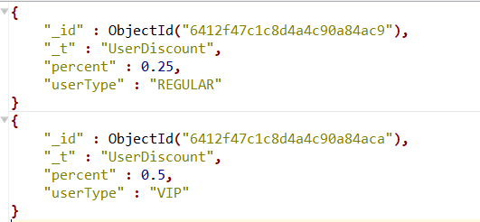
Application Overview - Database
discounts – contains percentage of discount for each type of user to be applied to the total price

Slide 9
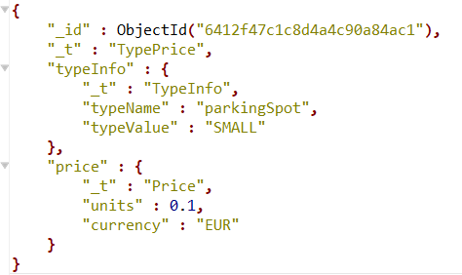
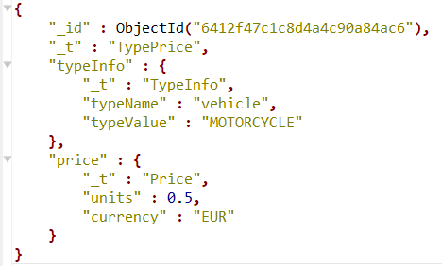
Application Overview - Database
prices – contains the prices for each parking spot type, vehicle type, and user type

Slide 10
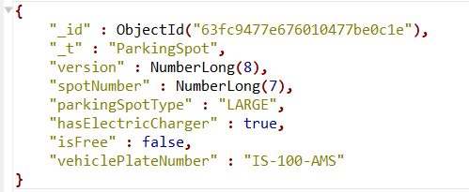
Application Overview - Database
parkingSpots – contains the list of parking spots

Slide 11
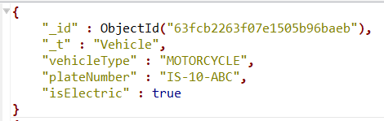
Application Overview - Database
vehicles – contains the vehicles that have been stored by users in their account

Slide 12
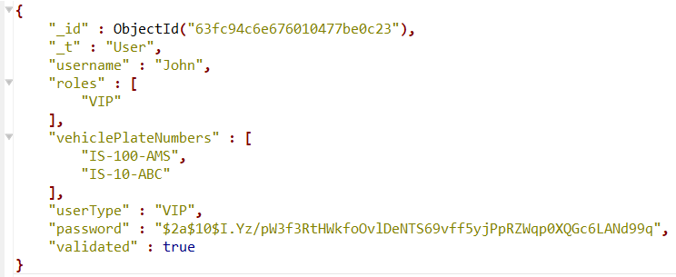
Application Overview - Database
users – contains the registered users

Slide 13
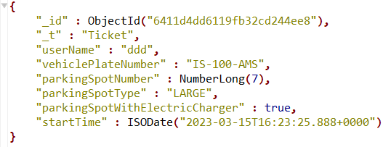
Application Overview - Database
tickets – contains the tickets that were generated after a successful parking

Slide 14
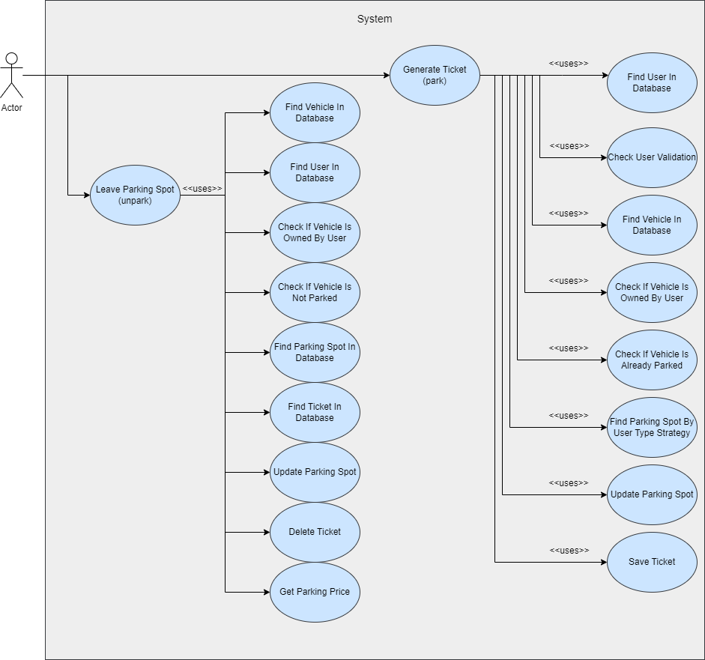
Use Cases - User

Slide 15
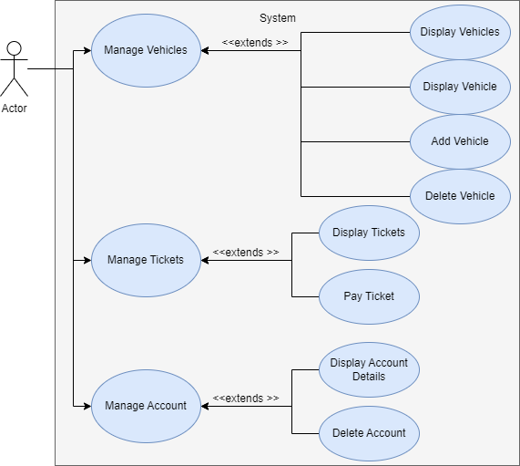
Use Cases - User

Slide 16
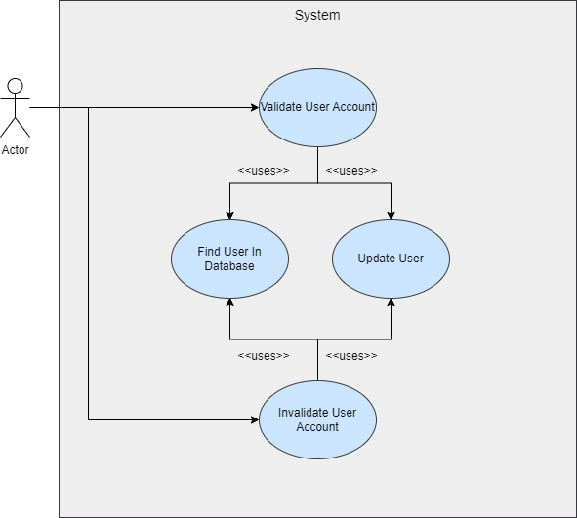
Use Cases - Admin

Slide 17

DEMO

